Slide 1


Initial Coverage Report – UltraTech Cement
By- Syed Kawish Ahmad

Slide 2
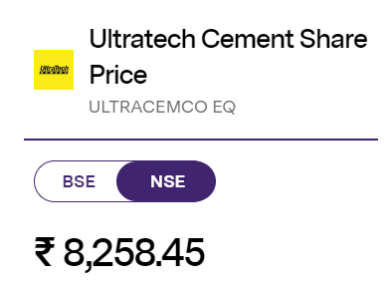
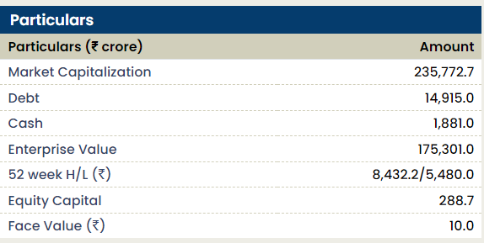
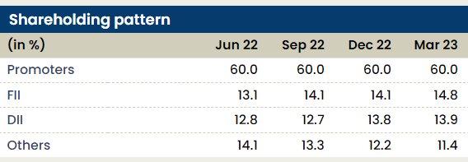
Company Overview -:
UltraTech Cement Limited is the largest manufacturer of grey cement, ready mix concrete (RMC), and white cement in India. It is a subsidiary of the Aditya Birla Group, a multinational conglomerate. UltraTech Cement has a strong presence both domestically and internationally, operating across five continents. The company has a wide network of over 100 plants, 26 grinding units, and more than 7,000 distributors and retailers

Slide 3
Q3FY23 Results: UltraTech Cement reported a mixed performance. While volume growth remained healthy, flat realisation led to muted recovery in the margins.
Net revenues grew 20.3% YoY to | 15,008 crore (vs I-direct estimate. | 15,146 crore). It was up 11.3% QoQ
Cost of production declined 1.9% QoQ to | 5,214/t, mainly led by lower other expenses.
As a result, EBITDA/t improved 12.1% QoQ to | 869/t (vs. I-direct estimate: | 966/t). On a YoY basis, it declined 44.6%
Net profit improved sequentially by 38.4% to | 994 crore though it was lower than I-direct estimated net profit of | 1174 crore

Slide 4
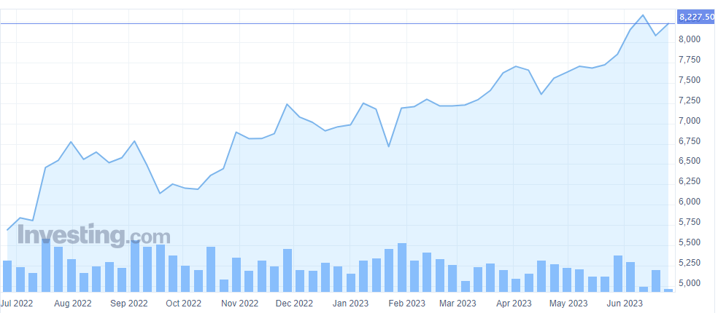
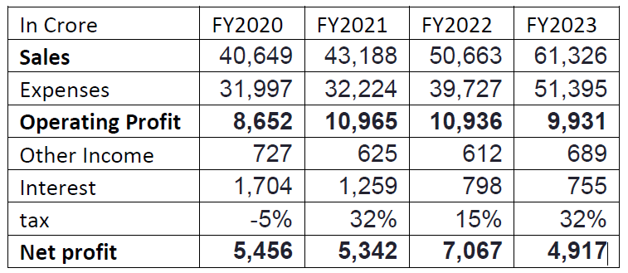
Price Pattern :-
Key Financials Summary :-

Slide 5
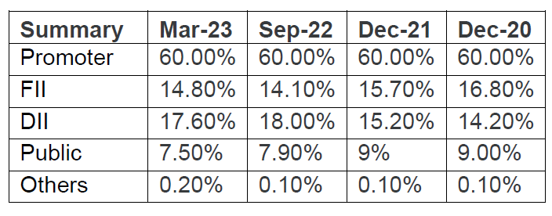
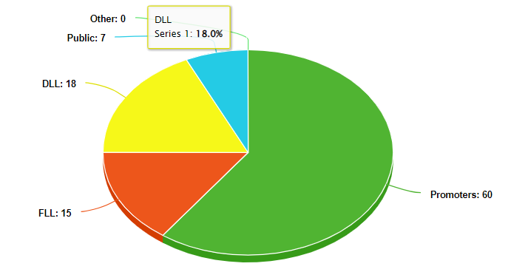
Share Holding Patten of Ultratech Cement:
Pie Chart :-

Slide 6
Key Takeaways from Conference call on Ultratech Cement :-
1. As of the end of June, the company had over 50 days worth of inventory for pet coke and
thermal coke combined. The company's FY23 capex guidance has been revised and is
expected to increase by approximately INR6,000 crore. In 1Q23, the trade mix was 67%, with
a blended ratio of 70%. If starting from scratch today at current prevailing prices, the
replacement cost for the industry would be pegged between plus minus $110-120. With only
20 months left until the election and a significant amount of tailwinds for demand, there has
been an increase in demand that is typically seen in pre-election years.
2. The overall utilization rate is currently at 83%, with double-digit increases in the north and
central regions, while west and east have seen a rise of around 5-6%, and south remains
unchanged. The company expects expansions to deliver an EBITDA of INR1,400-1,500 crore
with a ROCE of over 15% and investments totaling INR12,866 crores.
3. During the June quarter exit realizations were slightly lower than average due to monsoon
season which caused realizations to drop by around 3-5%. Energy costs are volatile with
daily costs on an upward trend. On a consolidated basis net debt has increased slightly
reaching INR5,561 crore with INR4,670 crore being held in India.
4. Currently reaching a blended ratio of 70% for Phase 2 expansion on a consolidated basis
means that there may be room for percentage improvement moving forward.

Slide 7
Quarterly results :-
 | Mar '23 | Dec '22 | Sep '22 | Jun '22 | Mar '22
Net Sales/Income from operations | 18,121.02 | 15,008.02 | 13,481.98 | 14,715.48 | 15,167.54
Other Operating Income | -- | -- | -- | -- | --
Total Income From Operations | 18,121.02 | 15,008.02 | 13,481.98 | 14,715.48 | 15,167.54
EXPENDITURE
Consumption of Raw Materials | 2,450.20 | 2,171.45 | 1,937.16 | 1,945.32 | 1,989.14
Purchase of Traded Goods | 798.58 | 778.99 | 740.09 | 703.04 | 736.26
Increase/Decrease in Stocks | 241.66 | -347.72 | -294.75 | -89.56 | 151.90
Power & Fuel | 4,623.39 | -- | 3,902.57 | -- | 3,594.84
Employees Cost | 873.24 | 648.51 | 644.49 | 595.36 | 586.40
Depreciation | 694.81 | 653.53 | 642.74 | 628.16 | 637.39
Other Expenses | 5,992.93 | 9,611.97 | 4,836.45 | 8,631.95 | 5,166.07
P/L Before Other Inc. , Int., Excpt. Items & Tax | 2,446.21 | 1,491.29 | 1,073.23 | 2,301.21 | 2,305.54
Other Income | 200.55 | 158.21 | 164.54 | 166.13 | 144.79
P/L Before Int., Excpt. Items & Tax | 2,646.76 | 1,649.50 | 1,237.77 | 2,467.34 | 2,450.33
Interest | 174.87 | 193.70 | 186.74 | 199.69 | 174.71
P/L Before Exceptional Items & Tax | 2,471.89 | 1,455.80 | 1,051.03 | 2,267.65 | 2,275.62
Exceptional Items | -- | -- | -- | -- | --
P/L Before Tax | 2,471.89 | 1,455.80 | 1,051.03 | 2,267.65 | 2,275.62
Tax | 821.63 | 461.57 | 332.66 | 713.63 | -178.27

Slide 8
P/L After Tax from Ordinary Activities | 1,650.26 | 994.23 | 718.37 | 1,554.02 | 2,453.89
EPS Before Extra Ordinary
Basic EPS | 57.24 | 34.48 | 24.91 | 53.88 | 85.08
Diluted EPS | 57.21 | 34.47 | 24.90 | 53.86 | 85.04
EPS After Extra Ordinary
Basic EPS | 57.24 | 34.48 | 24.91 | 53.88 | 85.08
Diluted EPS | 57.21 | 34.47 | 24.90 | 53.86 | 85.04

Slide 9
Peer Comparison :-
S.No. | Name | CMP Rs. | P/E | Mar Cap Rs.Cr. | Div Yld % | NP Qtr Rs.Cr.
1 | UltraTech Cem. | 7556.2 | 44.36 | 218137.18 | 0.5 | 1650.26
2 | Shree Cement | 24334.45 | 62.66 | 87800.52 | 0.37 | 281.83
3 | Ambuja Cements | 396.5 | 38.26 | 78730.83 | 1.59 | 487.88
4 | ACC | 1762.85 | 54.18 | 33104.08 | 3.29 | 235.66
5 | J K Cements | 2993.3 | 45.49 | 23128.71 | 0.5 | 37.16
6 | Nuvoco Vistas | 329.9 |  | 11782.58 | 0 | -75.29
7 | JK Lakshmi Cem. | 782.15 | 20.42 | 9203.56 | 0.64 | 77.42

Slide 10
Financial & Valuations :-
Year is April-March. All values | 2022 | 2021 | 2020 | 2019 | 2018
Cash & Short Term Investments | 53,225 | 129,014 | 47,836 | 22,562 | 41,682
Cash Only | 1,332 | 1,895 | 1,594 | 4,532 | 2,126
Cash & Short Term Investments Growth | -58.74% | 169.70% | 112.02% | -45.87% | -
Cash & ST Investments / Total Assets | 6.32% | 14.91% | 5.93% | 2.88% | 7.29%
Total Accounts Receivable | 43,183 | 45,736 | 37,340 | 40,321 | 28,794
Accounts Receivables, Net | 30,716 | 25,717 | 23,832 | 27,870 | 22,206
Accounts Receivables, Gross | 32,169 | 27,202 | 25,191 | 28,528 | 22,696
Bad Debt/Doubtful Accounts | -1,453 | -1,485 | -1,359 | -658 | -490
Other Receivables | 12,467 | 20,019 | 13,508 | 12,451 | 6,588
Accounts Receivable Growth | -5.58% | 22.48% | -7.39% | 40.03% | -
Accounts Receivable Turnover | 12.02 | 9.69 | 11.21 | 10.17 | 10.63
Inventories | 64,279 | 45,526 | 48,261 | 46,664 | 37,233
Finished Goods | 5,477 | 4,651 | 7,707 | 4,749 | 3,153

Slide 11
Work in Progress | 9,430 | 6,352 | 7,974 | 7,074 | 6,133
Raw Materials | 26,891 | 17,300 | 13,445 | 17,145 | 14,038
Progress Payments & Other | 22,481 | 17,224 | 19,134 | 17,696 | 13,909
Other Current Assets | 14,112 | 10,261 | 7,716 | 9,061 | 6,905
Prepaid Expenses | 706 | 1,281 | 525 | 479 | 335
Miscellaneous Current Assets | 13,406 | 8,980 | 7,191 | 8,582 | 6,569
Total Current Assets | 174,799 | 230,537 | 141,153 | 118,607 | 114,613
Net Property, Plant & Equipment | 509,773 | 474,731 | 480,648 | 476,265 | 392,535
Property, Plant & Equipment - Gross | 642,432 | 584,110 | 567,339 | 540,145 | 434,870
Buildings | 57,343 | 55,160 | 54,207 | 51,301 | 43,458
Land & Improvements | 79,224 | 64,640 | 64,565 | 63,897 | 54,289
Machinery & Equipment | 404,009 | 384,551 | 382,279 | 370,948 | 280,479
Construction in Progress | 72,065 | 38,478 | 27,834 | 29,832 | 36,159
Leases | 1,991 | 13,013 | 11,676 | 11,026 | 9,326
Transportation Equipment | 1,628 | 1,333 | 1,221 | 1,105 | 907
Other Property, Plant & Equipment | 14,388 | 13,592 | 12,823 | 12,036 | 8,830
Accumulated Depreciation | 132,659 | 109,379 | 86,691 | 63,880 | 42,335
Buildings | 13,049 | 10,843 | 8,614 | 6,292 | 4,267
Land & Improvements | 2,387 | - | - | - | -
Machinery & Equipment | 109,481 | 90,178 | 71,514 | 53,131 | 34,613
Leases | - | - | - | - | 374
Other Assets | 13,114 | 18,516 | 18,376 | 21,968 | 7,031
Deferred Charges | 47 | 17 | 12 | 162 | 209
Tangible Other Assets | 13,067 | 18,499 | 18,365 | 21,806 | 6,822
Total Assets | 841,865 | 865,276 | 806,023 | 784,051 | 571,505
Assets - Total - Growth | -2.71% | 7.35% | 2.80% | 37.19% | -

Slide 12
Consolidated Cashflow Statement :-
CASH FLOW OF ULTRATECH CEMENT (in Rs. Cr.) | Mar-23 | Mar-22 | Mar-21 | Mar-20 | Mar-19
NET PROFIT/LOSS BEFORE EXTRAORDINARY ITEMS AND TAX | 0 | 8,364.40 | 7,857.64 | 5,182.72 | 3,468.45
Net CashFlow From Operating Activities | 0 | 9,283.24 | 12,502.95 | 8,972.43 | 5,956.11
Net Cash Used In Investing Activities | 0 | 2,257.01 | -8,859.00 | -4,192.42 | 1,113.82
Net Cash Used From Financing Activities | 0 | -12,497.93 | -4,356.47 | -5,075.88 | -6,757.24
Foreign Exchange Gains / Losses | 0 | -0.47 | 0.33 | 0.47 | 0.45
Adjustments On Amalgamation Merger Demerger Others | 0 | 0 | 0 | 0 | 50.91
NET INC/DEC IN CASH AND CASH EQUIVALENTS | 0 | -958.15 | -712.19 | -295.4 | 364.05
Cash And Cash Equivalents Begin of Year | 0 | 177.21 | 147.23 | 442.63 | 77.19
Cash And Cash Equivalents End Of Year | 0 | -780.94 | -564.96 | 147.23 | 441.24

Slide 13
Ratio Analysis :-
 | 19-Mar | 20-Mar | 21-Mar | 22-Mar | 23-Mar | 24-Mar
Debtor Days | 21 | 21 | 17 | 19 | 20 | 19
Inventory Days | 242 | 207 | 204 | 180 | 220 | 201
Days Payable | 173 | 162 | 162 | 205 | 228 | 284
Cash Conversion Cycle | 90 | 66 | 59 | -5 | 12 | -63
Working Capital Days | -26 | -5 | -1 | -22 | -4 | 19
ROCE % | 13% | 11% | 12% | 16% | 15% | 13%

Slide 14
Trend in EBITDA Margin :-
Period | Mar-20 | Mar-21 | Mar-22 | Mar-23
EBITDA Margin | 23.33 | 26.92 | 22.86 | 17.58
Change | 26.12% | 15.41% | -15.10% | -23.09%
Price | 3244.85 | 6737.95 | 6602.3 | 7622.15
Price Change | -18.85% | 107.65% | -2.01% | 15.45%

Slide 15
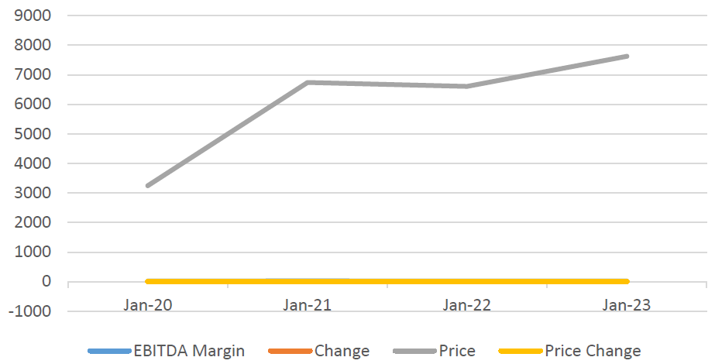
Trend in EBITDA Margin :-

Slide 16
Standalone Statement of Profit and Loss:-
PROFIT & LOSS ACCOUNT OF ULTRATECH CEMENT (in Rs. Cr.) | 20-Mar | 21-Mar | 22-Mar | 23-Mar
INCOME
REVENUE FROM OPERATIONS [GROSS] | 40,033.25 | 42,677.00 | 49,729.38 | 61,326.50
Less: Excise/Sevice Tax/Other Levies | 0 | 0 | 0 | 0
REVENUE FROM OPERATIONS [NET] | 40,033.25 | 42,677.00 | 49,729.38 | 61,326.50
TOTAL OPERATING REVENUES | 40,649.17 | 43,188.34 | 50,663.49 | 61,326.50
Other Income | 726.58 | 788.68 | 611.8 | 689.43
TOTAL REVENUE | 41,375.75 | 43,977.02 | 51,275.29 | 62,015.93
EXPENSES
Cost Of Materials Consumed | 4,960.81 | 5,174.94 | 6,459.77 | 8,504.13
Purchase Of Stock-In Trade | 2,262.78 | 1,936.70 | 2,458.19 | 3,020.70
Operating And Direct Expenses | 0 | 0 | 0 | 0
Changes In Inventories Of FG,WIP And Stock-In Trade | -362.74 | 426.44 | -358.37 | -490.37
Employee Benefit Expenses | 2,336.17 | 2,181.99 | 2,359.08 | 2,561.60
Finance Costs | 1,704.22 | 1,259.08 | 798.37 | 755
Depreciation And Amortisation Expenses | 2,454.90 | 2,434.35 | 2,456.76 | 2,619.24
Other Expenses | 22,814.15 | 22,526.86 | 28,808.40 | 37,799.26
TOTAL EXPENSES | 36,155.99 | 35,916.95 | 42,982.20 | 54,769.56
PROFIT/LOSS BEFORE EXCEPTIONAL, EXTRAORDINARY ITEMS AND TAX | 5,219.76 | 8,060.07 | 8,293.09 | 7,246.37
Exceptional Items | 0 | -164 | 0 | 0
PROFIT/LOSS BEFORE TAX | 5,219.76 | 7,896.07 | 8,293.09 | 7,246.37

Slide 17
Standalone Statement of Profit and Loss:-
TAX EXPENSES-CONTINUED OPERATIONS | 20-Mar | 21-Mar | 22-Mar | 23-Mar
Current Tax | 915.38 | 1,415.05 | 1,518.68 | 2,329.49
Less: MAT Credit Entitlement | 0 | 0 | 0 | 0
Deferred Tax | -1,154.41 | 1,138.95 | 13.02 | 0
Tax For Earlier Years | 3.25 | 0 | -305.15 | 0
TOTAL TAX EXPENSES | -235.78 | 2,554.00 | 1,226.55 | 2,329.49
PROFIT/LOSS AFTER TAX AND BEFORE EXTRAORDINARY ITEMS | 5,455.54 | 5,342.07 | 7,066.54 | 4,916.88
PROFIT/LOSS FROM CONTINUING OPERATIONS | 5,455.54 | 5,342.07 | 7,066.54 | 4,916.88
PROFIT/LOSS FOR THE PERIOD | 5,455.54 | 5,342.07 | 7,066.54 | 4,916.88
OTHER ADDITIONAL INFORMATION
EARNINGS PER SHARE
Basic EPS (Rs.) | 189.15 | 185.2 | 245 | 170.53
Diluted EPS (Rs.) | 189.1 | 185.13 | 244.9 | 170.44
VALUE OF IMPORTED AND INDIGENIOUS RAW MATERIALS STORES, SPARES AND LOOSE TOOLS
Imported Raw Materials | 0 | 0 | 0 | 0
Indigenous Raw Materials | 0 | 0 | 0 | 0
STORES, SPARES AND LOOSE TOOLS
Imported Stores And Spares | 0 | 0 | 0 | 0
Indigenous Stores And Spares | 0 | 0 | 0 | 0
DIVIDEND AND DIVIDEND PERCENTAGE
Equity Share Dividend | 380.56 | 374.95 | 1,067.03 | 0
Tax On Dividend | 0 | 0 | 0 | 0
Equity Dividend Rate (%) | 130 | 370 | 380 | 0

Slide 18
Stocks CAGR of Ultratech Cement :-
Stock Price CAGR
10 Years: | 15%
5 Years: | 13%
3 Years: | 29%
1 Year: | 14%
Return on Equity :-
Return on Equity
10 Years: | 12%
5 Years: | 12%
3 Years: | 12%
Last Year: | 10%

